Slide 1


200 years of Freedom
Greece 2021
Celebrations around the world

Slide 2
Boston Bridge

Slide 3
San Francisco - California

Slide 4
Los Angeles

Slide 5
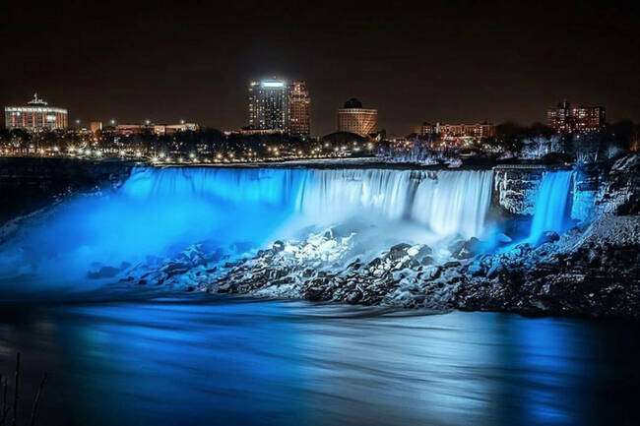
Niagara Falls - Canada

Slide 6
Sydney – Opera House

Slide 7
Rhode Island – State House

Slide 8
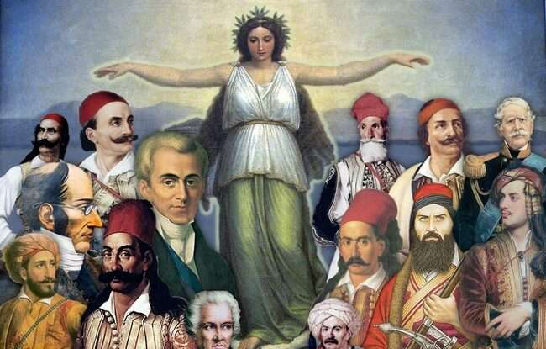
Thank you all!
Music: Vangelis Papathanasiou

